Slide 1
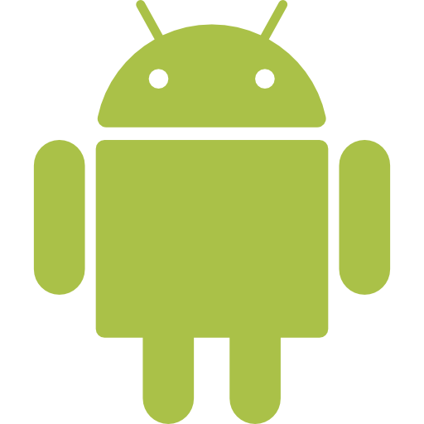

Android Platform
Introduction to
Aitrich Technologies | Android Fundamentals

Slide 2

Software Features
Android supports many built‑in software features for better mobile experience.
• Integrated web browser with WebKit engine
• Supports audio, video, images, and multimedia
• Supports multitasking and notifications
• Works with Wi‑Fi, Bluetooth, GPS, and sensors
• Provides smooth UI and touch support

Slide 3
Dalvik vs ART
Android uses runtime environments to execute applications
• Dalvik VM uses JIT (Just‑In‑Time) compilation
• ART uses AOT (Ahead‑Of‑Time) compilation
• ART gives faster app performance
• Dalvik uses more CPU during runtime
• ART improves battery life and efficiency

Slide 4
Open Handset Alliance (OHA)
OHA is a group of companies supporting Android development.
• Founded by Google in 2007
• Includes hardware and software companies
• Promotes open mobile standards
• Supports Android ecosystem growth
• Helps improve mobile innovation

Slide 5
Cellular Networks
Mobile networks help devices communicate wirelessly.
• 2G supports voice calls and SMS
• 3G introduced mobile internet and video calls
• 4G provides faster streaming and gaming
• 5G offers very high speed and low latency
• Used for internet and communication services

Slide 6
Wi‑Fi, Bluetooth & LAN
Android devices support multiple connectivity technologies.
• Wi‑Fi connects devices to wireless internet
• Bluetooth enables short‑range communication
• LAN connects devices in local area network
• Used for file sharing and data transfer
• Supports wireless device communication

Slide 7
Android Security
Android provides security features to protect users and data
• Application sandboxing for security isolation
• Permission system controls app access
• Google Play Protect scans harmful apps
• Supports screen lock and encryption
• Regular security updates improve protection

Slide 8
SDK, AVD & ADB
Android development uses different developer tools.
• SDK contains Android development libraries and tools
• AVD is Android emulator for testing apps
• ADB helps connect device with computer
• Used for debugging and app installation
• Important tools in Android Studio

Slide 9
Developer Guides & Documentation
Android documentation helps developers learn and build apps.
• Official documentation provided by Google
• Contains API references and tutorials
• Provides code examples and guides
• Helps beginners and advanced developers
• Available online for free learning

